Slide 1
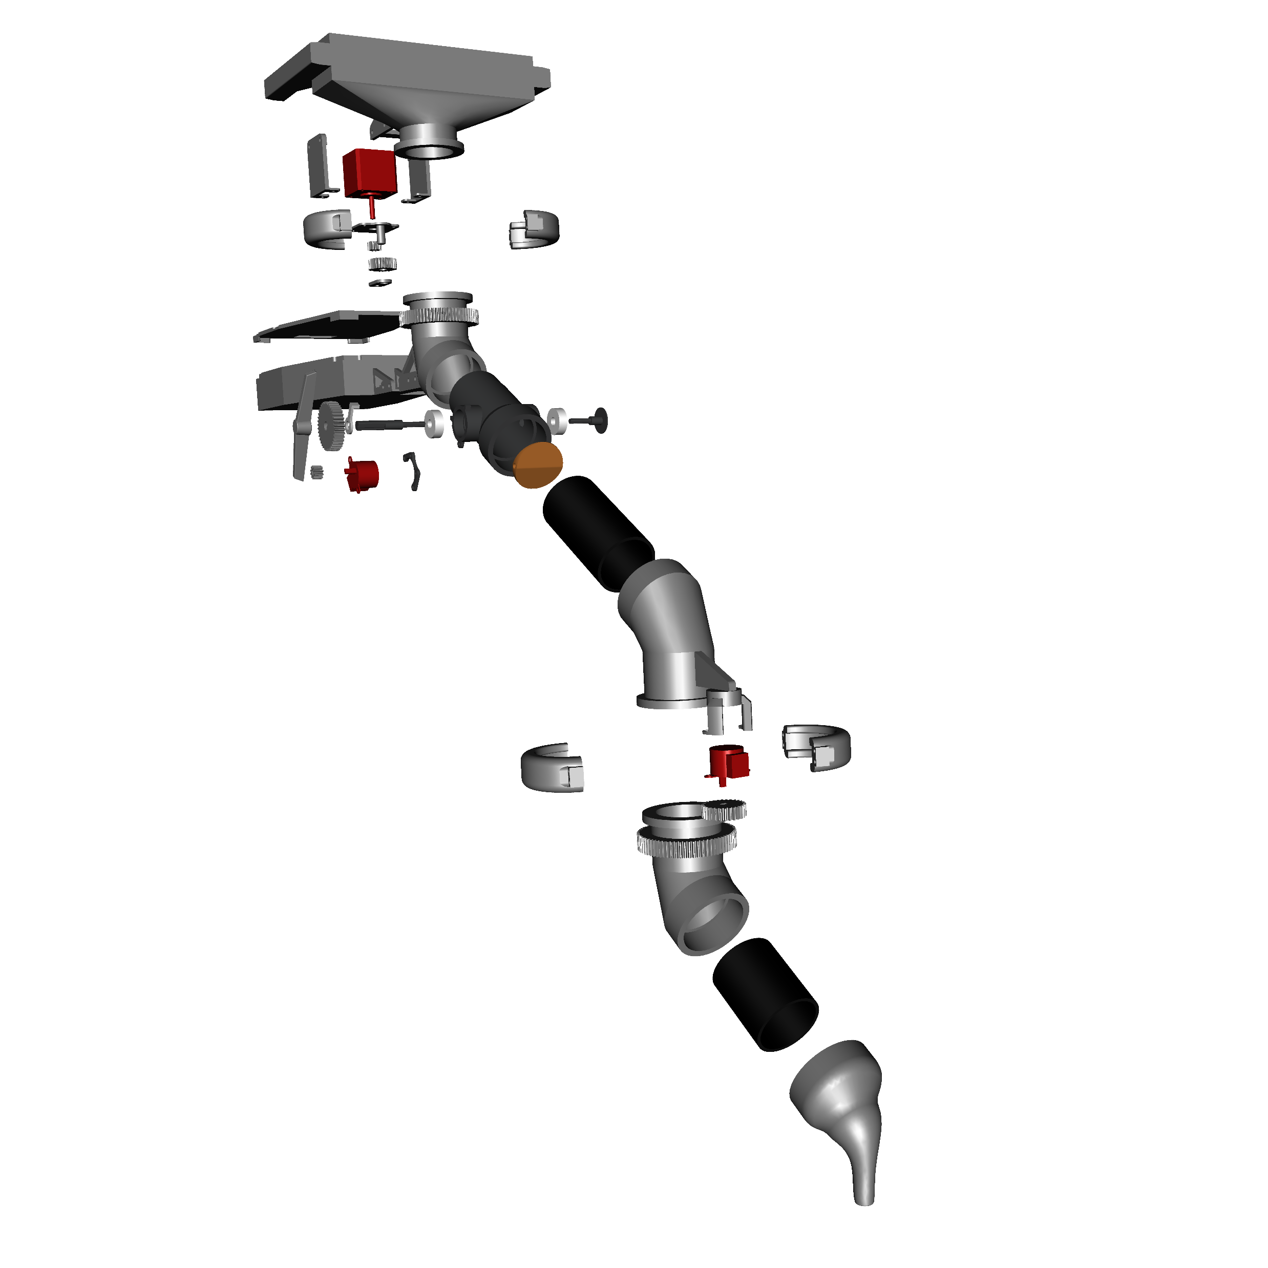
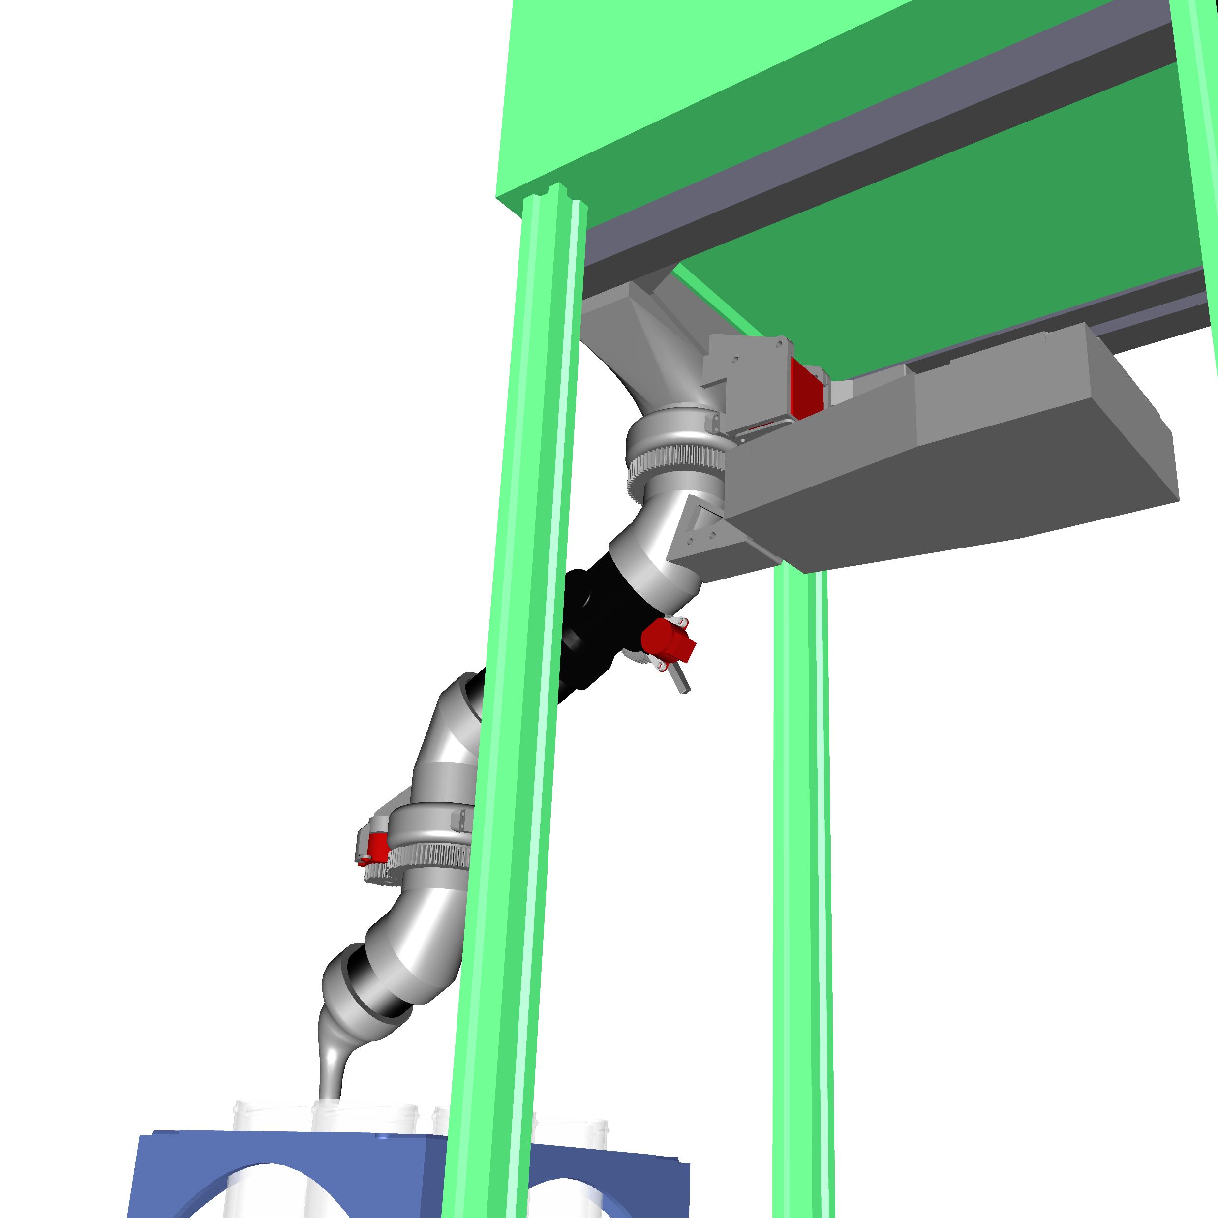
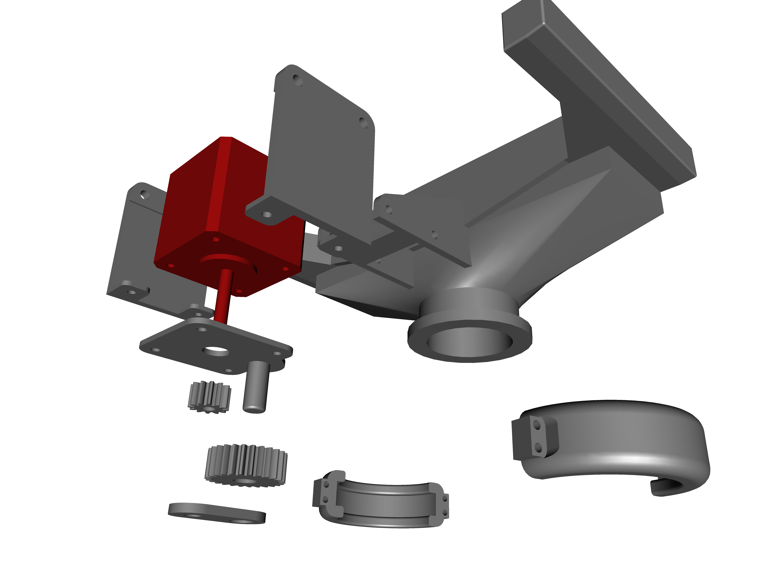
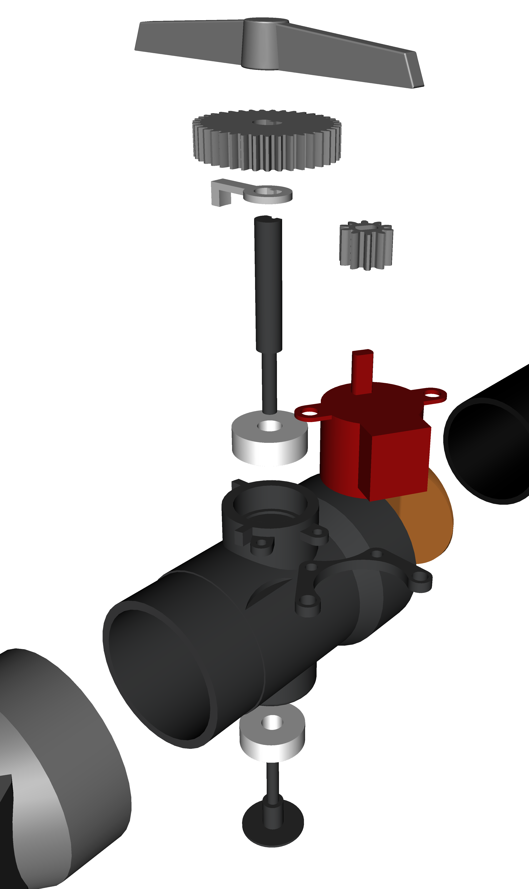
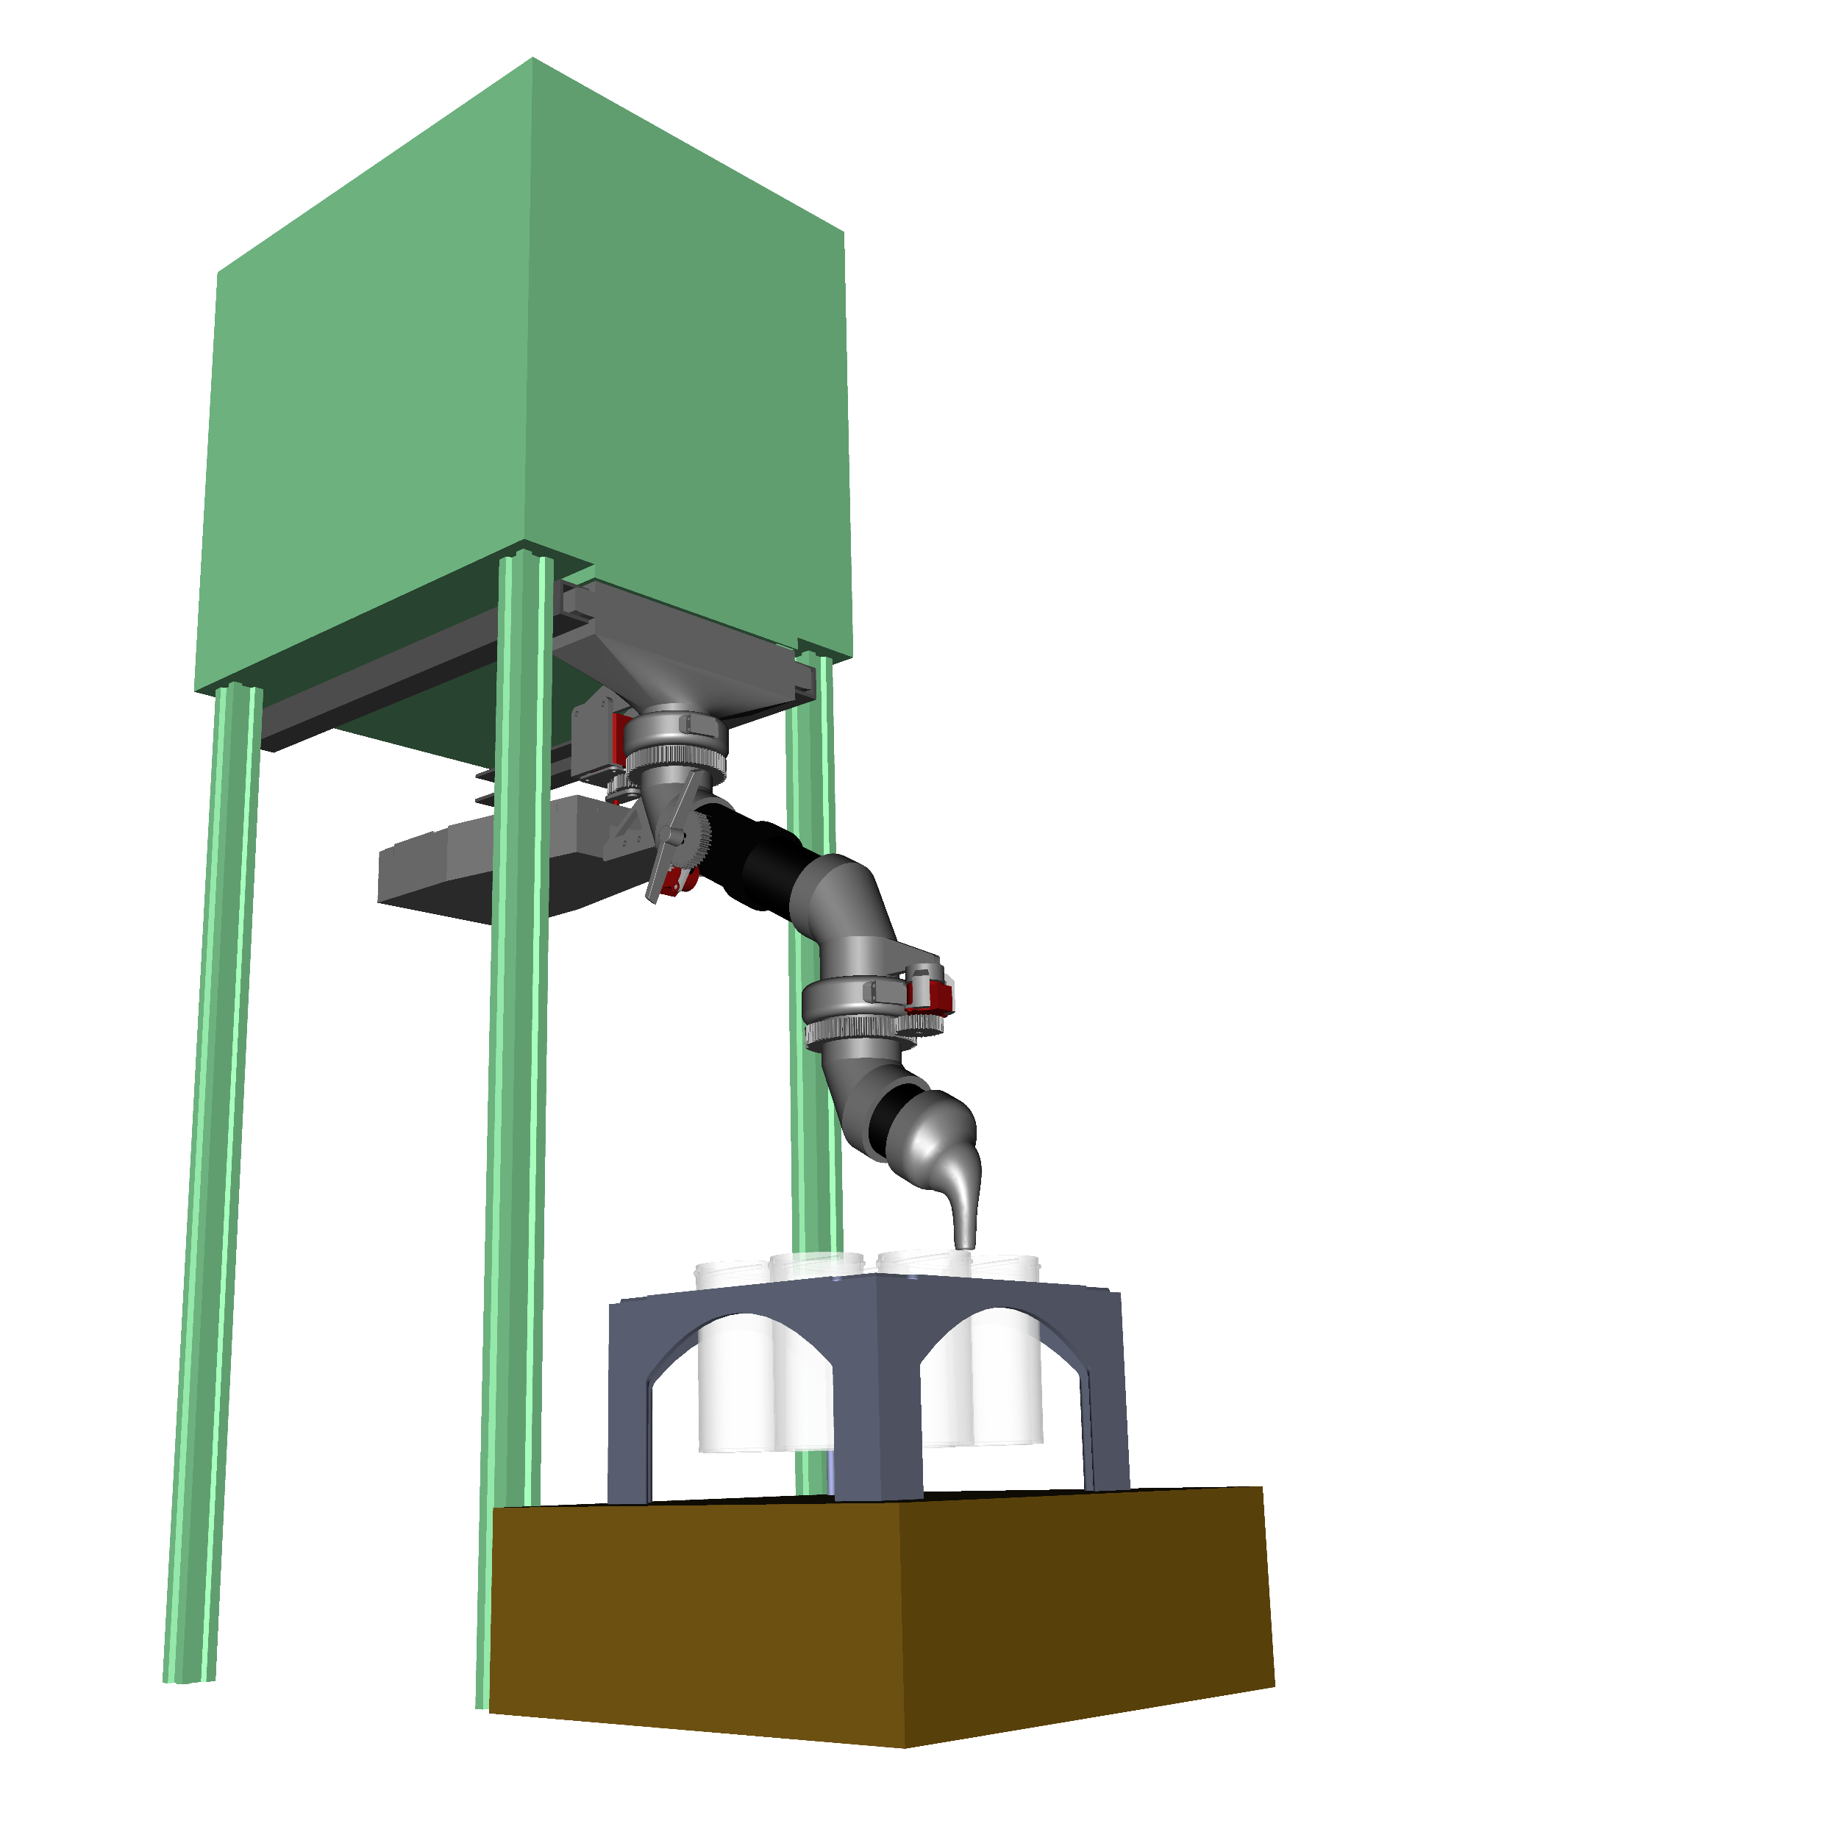
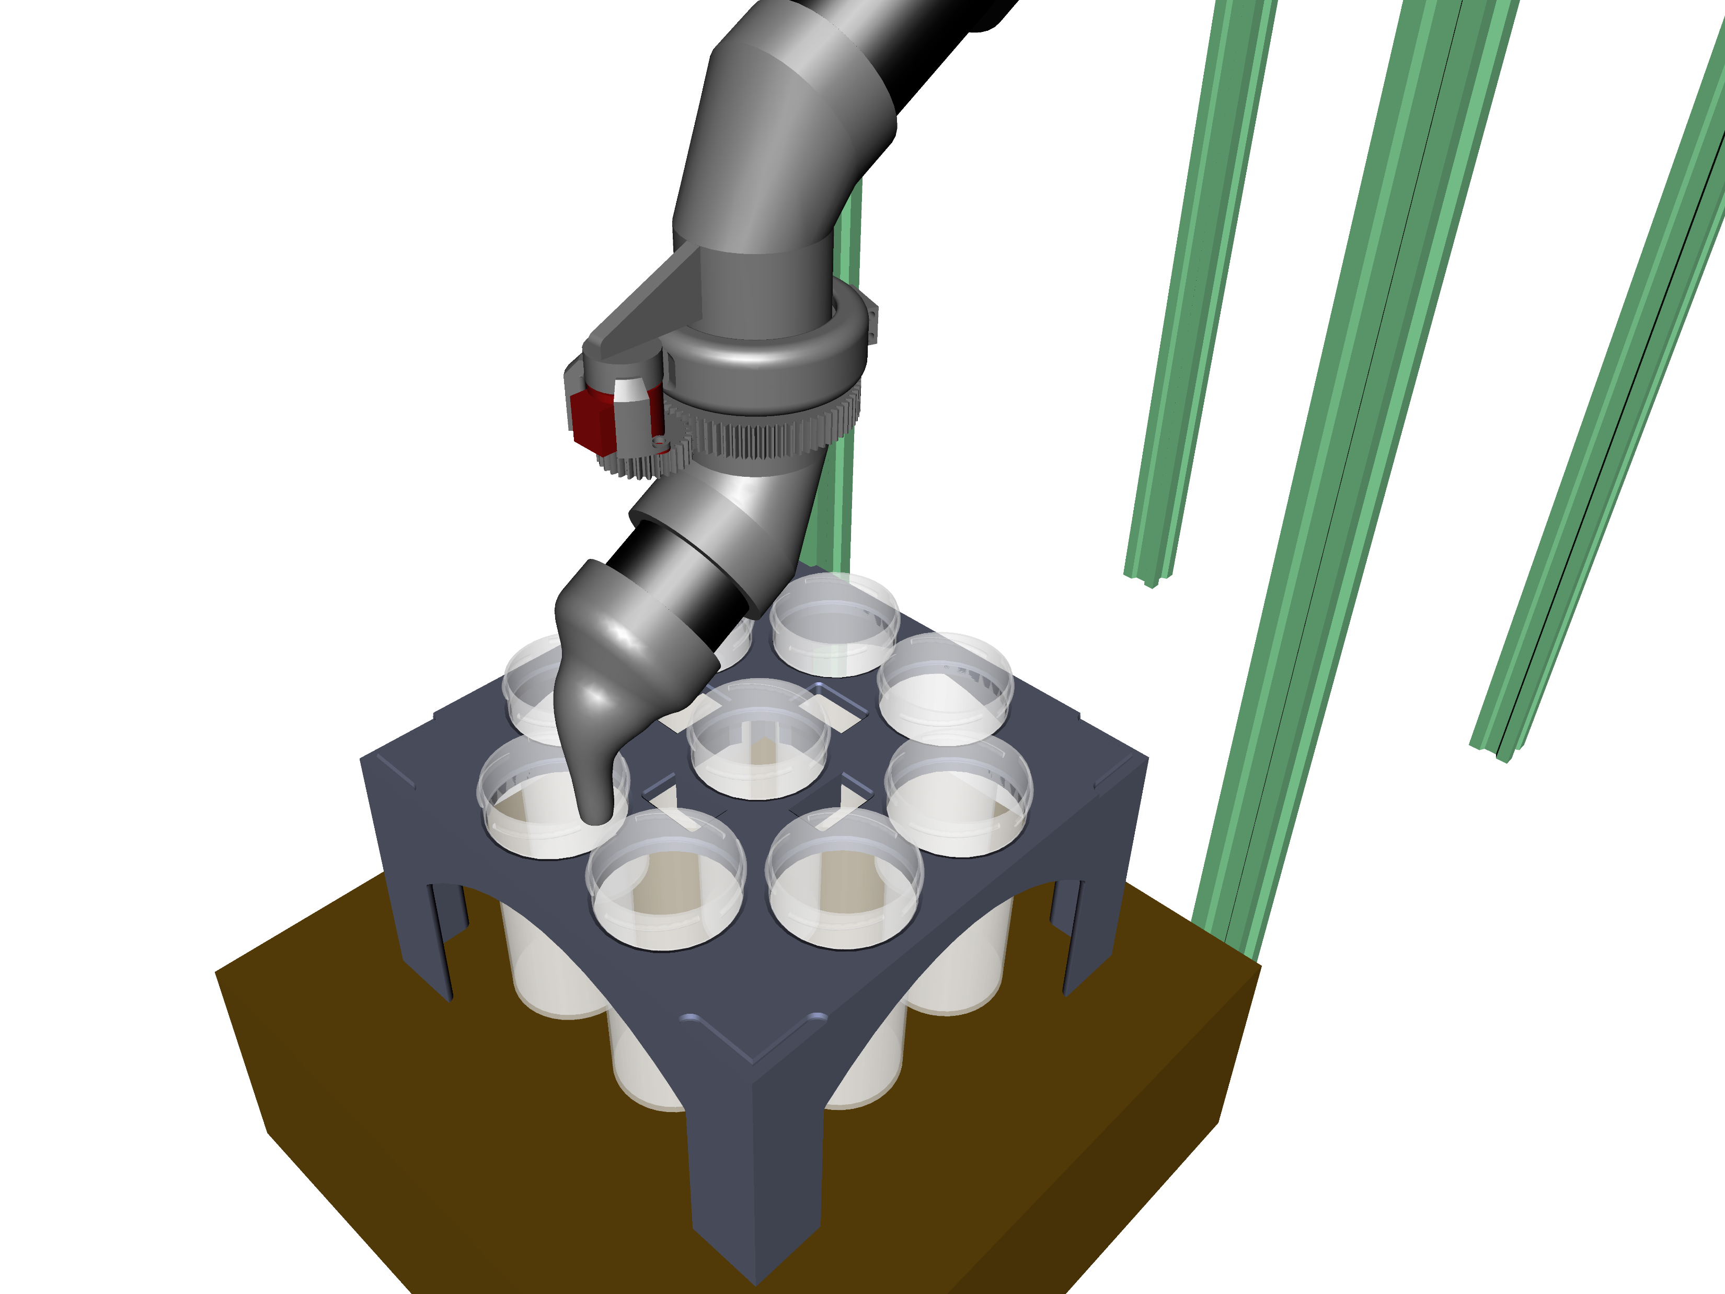
Pellet sorter
Top mount
Two-jointed articulated tube that allows for the distribution of pellets into standard cups on a tray, according to their composition, effectively automating the output of the extrusion process.
Using an Arduino microcontroller, connected by serial to Python. Inverse Kinematics (with the IKPy library) enable the nozzle to reach every point on the plane, making the design compatible with any tray and cup layout.
Scale connected by serial, permitting the individual measurement of each cup’s fill level. When full, the valve closes and the tube pivots to the next available one, taring the balance in the process.
With Data Classes, the Python script can track and account for any variations in the location of the trays, the layout of their slots and their occupancy state, as well as the contents of each cup.
Valve
Pelletizer
Scale

